Slide 1
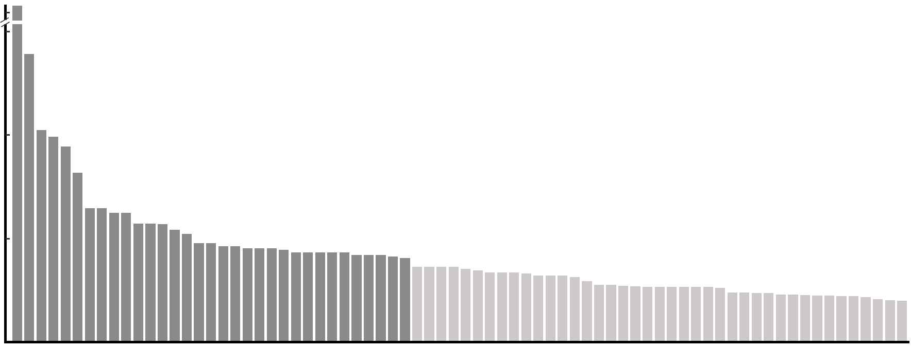
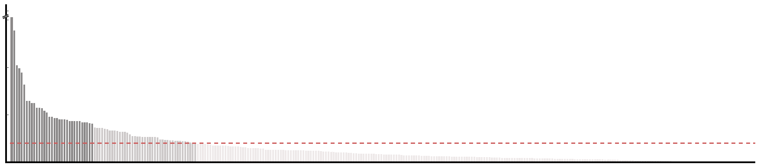
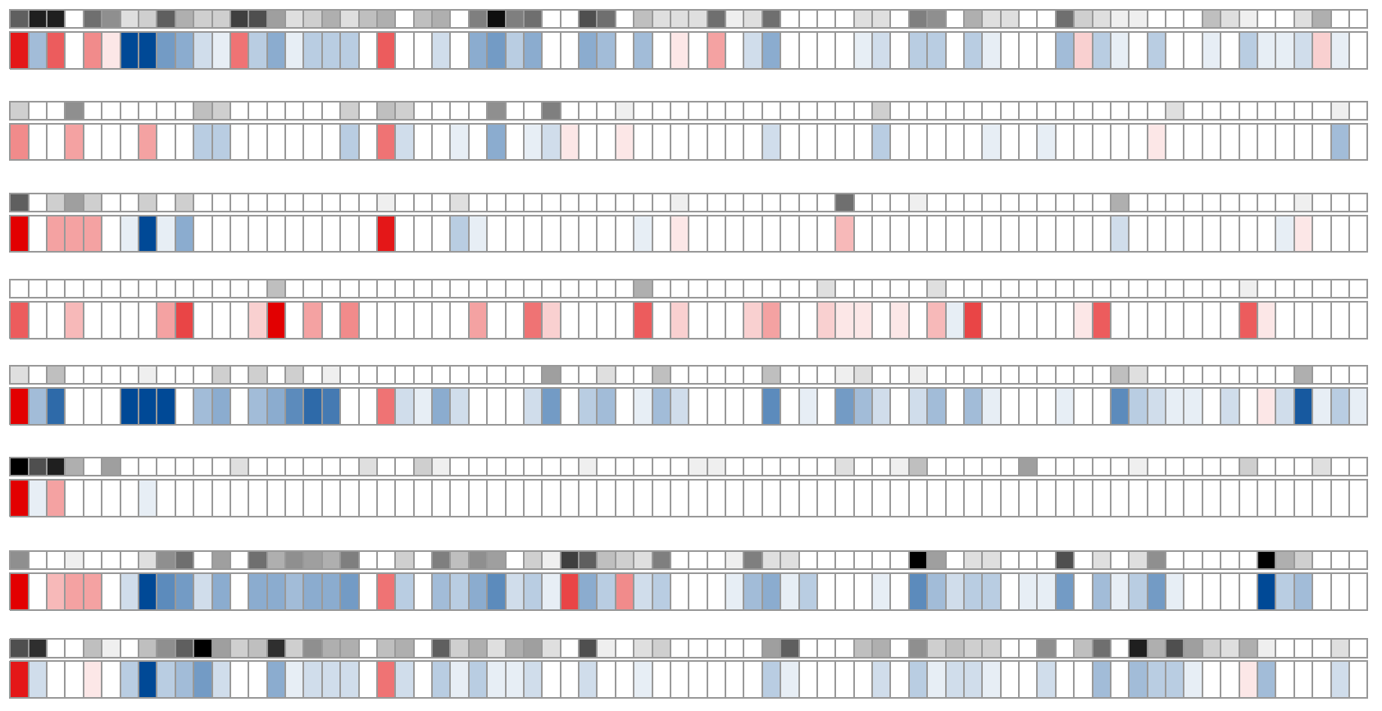
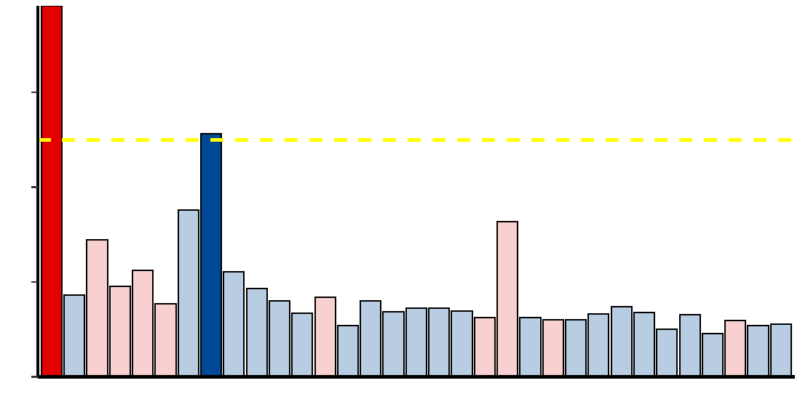
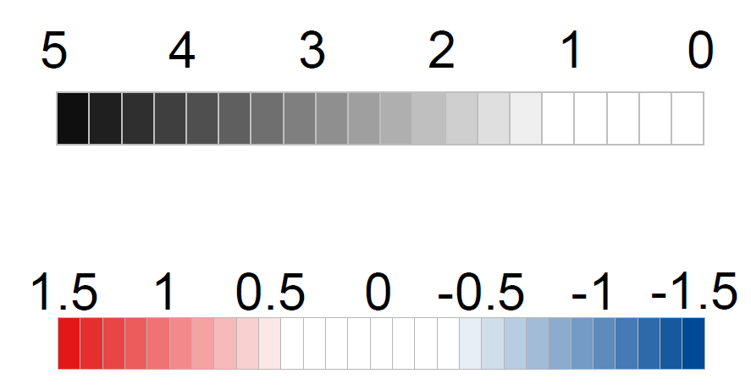
Figure 1
Fungal features selection
(control vs. CRC)
a
17.0
7.5
17.0
- log₁₀ FDR
7.5
- log₁₀ FDR
5.0
5.0
2.5
FDR < 0.1
2.5
0.0
FDR < 0.01
b
0.0
d
Aspergillus rambellii
2014_ZellerG
(EU)
1e+04
2.6e-04
0.017
1.3e-04
4.4e-07
1.3e-03
1.2e-04
2015_FengQ
(OC)
1e+02
0.018
2016_VogtmannE
(NA)
1e+00
2019_ThomasAM
(EU)
1e-02
2019_WirbelJ
(EU)
Aspergillus kawachii
1e+04
0.016
0.012
0.02
0.006
2019_YachidaS
(AS)
2017_YuJ
(AS)
1e+01
2021_ YuJ
(AS)
1e-02
Aspergillus rambellii
Rhizophagus irregularis
Moniliophthora perniciosa
Erysiphe pulchra
Sphaerulina musiva
Phytophthora capsici
Trichophyton mentagrophytes
Aspergillus kawachii
Pneumocystis murina
Debaryomyces hansenii
Trichoderma atroviride
Pseudocercospora musae
Cordyceps sp. RAO−2017
Rhizophagus clarus
Pichia kudriavzevii
Paracoccidioides brasiliensis
Albugo candida
Lipomyces starkeyi
Naumovozyma dairenensis
Phytopythium vexans
Aspergillus ochraceoroseus
Colletotrichum fioriniae
Coniochaeta ligniaria
Leucoagaricus sp. SymC.cos
Colletotrichum salicis
[Candida] arabinofermentans
Baudoinia panamericana
Hyaloscypha variabilis
Schizosaccharomyces pombe
Tuber magnatum
Thielaviopsis punctulata
Edhazardia aedis
Choanephora cucurbitarum
2014_ZellerG
(EU)
2015_FengQ
(OC)
2019_WirbelJ
(EU)
2019_YachidaS
(AS)
2017_YuJ
(AS)
2021_ YuJ
(AS)
2016_VogtmannE
(NA)
2019_ThomasAM
(EU)
c
- log₁₀(p value)
abs( log₂ FC )
1.2
abs( log₂ FC ) > 1.0
0.8
log₂(Fold change)
0.4
0.0
CRC Enriched
CRC Depleted
Notes:
F:\GitHub\multi-CRC-fungi\07.FeatureSelection\03.Plot
With multiple criteria, we obtained 74 significant different features, 33 mainly different features and 2 core features.
We also explored the performance of these 74 features in different cohorts and do some comparison between Control group and CRC group.
In order to validation our results, we utilized the same method in bacteria selection.

